Slide 1

Pediatrics in Canada

Slide 2
TABLE OF CONTENTS
01.
Pediatrics Profile
02.
Pediatricians around Canada
03.
Medical Schools
04.
Age and Gender

Slide 3
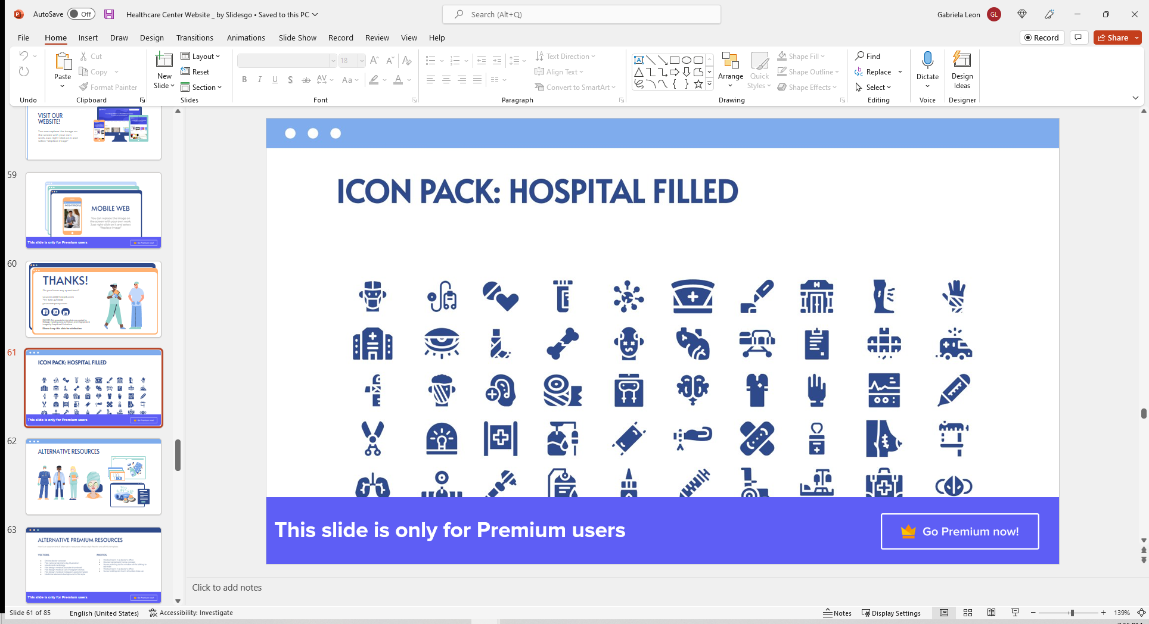
Pediatrics Profile
Youth health
Subspecialties
School and Certification

Slide 4
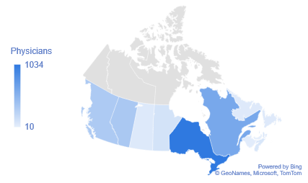
Pediatricians around Canada,2015
39%
Ontario
23%
Quebec
Source: 2014/15 Annual Census of Post-MD Trainees, CAPER

Slide 5
Total and Ministry funded postgraduate MD trainees in 2014/15
Source: 2014/15 Annual Census of Post-MD Trainees, CAPER

Slide 6
Age and Gender, 2015
1,096
43%
1,479
57%
Source: 2014/15 Annual Census of Post-MD Trainees, CAPER

Slide 7
THANKS!
Do you have any questions?
gabrielaleon2783@gmail.com
+12499792918
Please keep this slide for attribution

